Slide 1
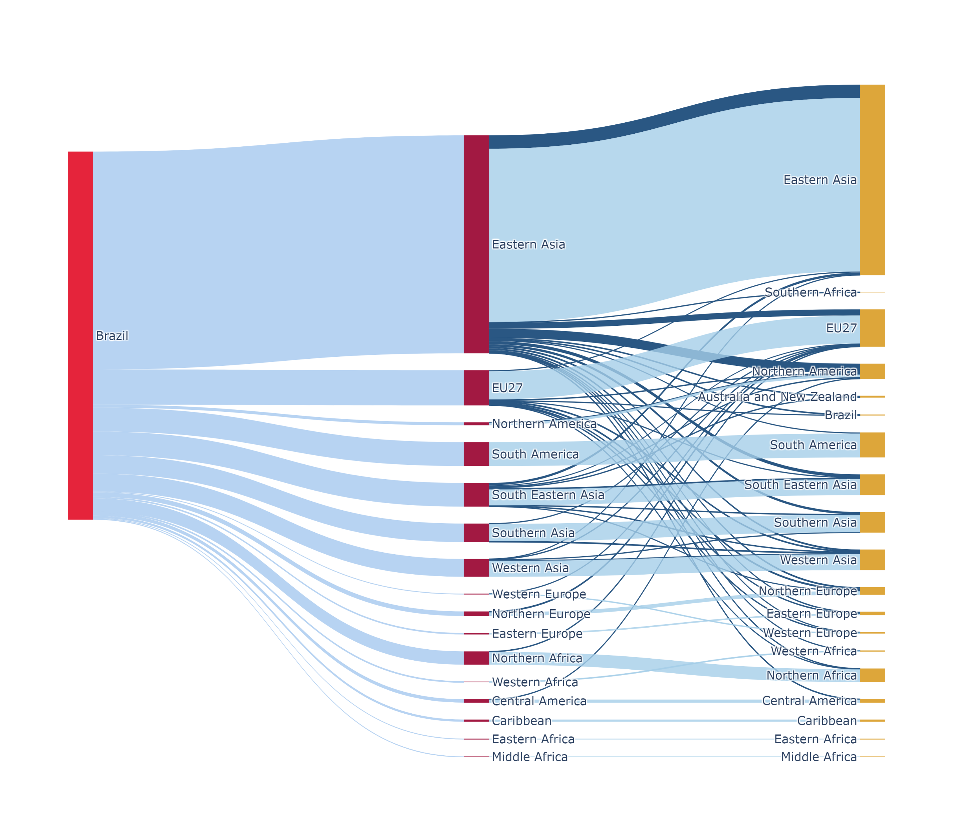
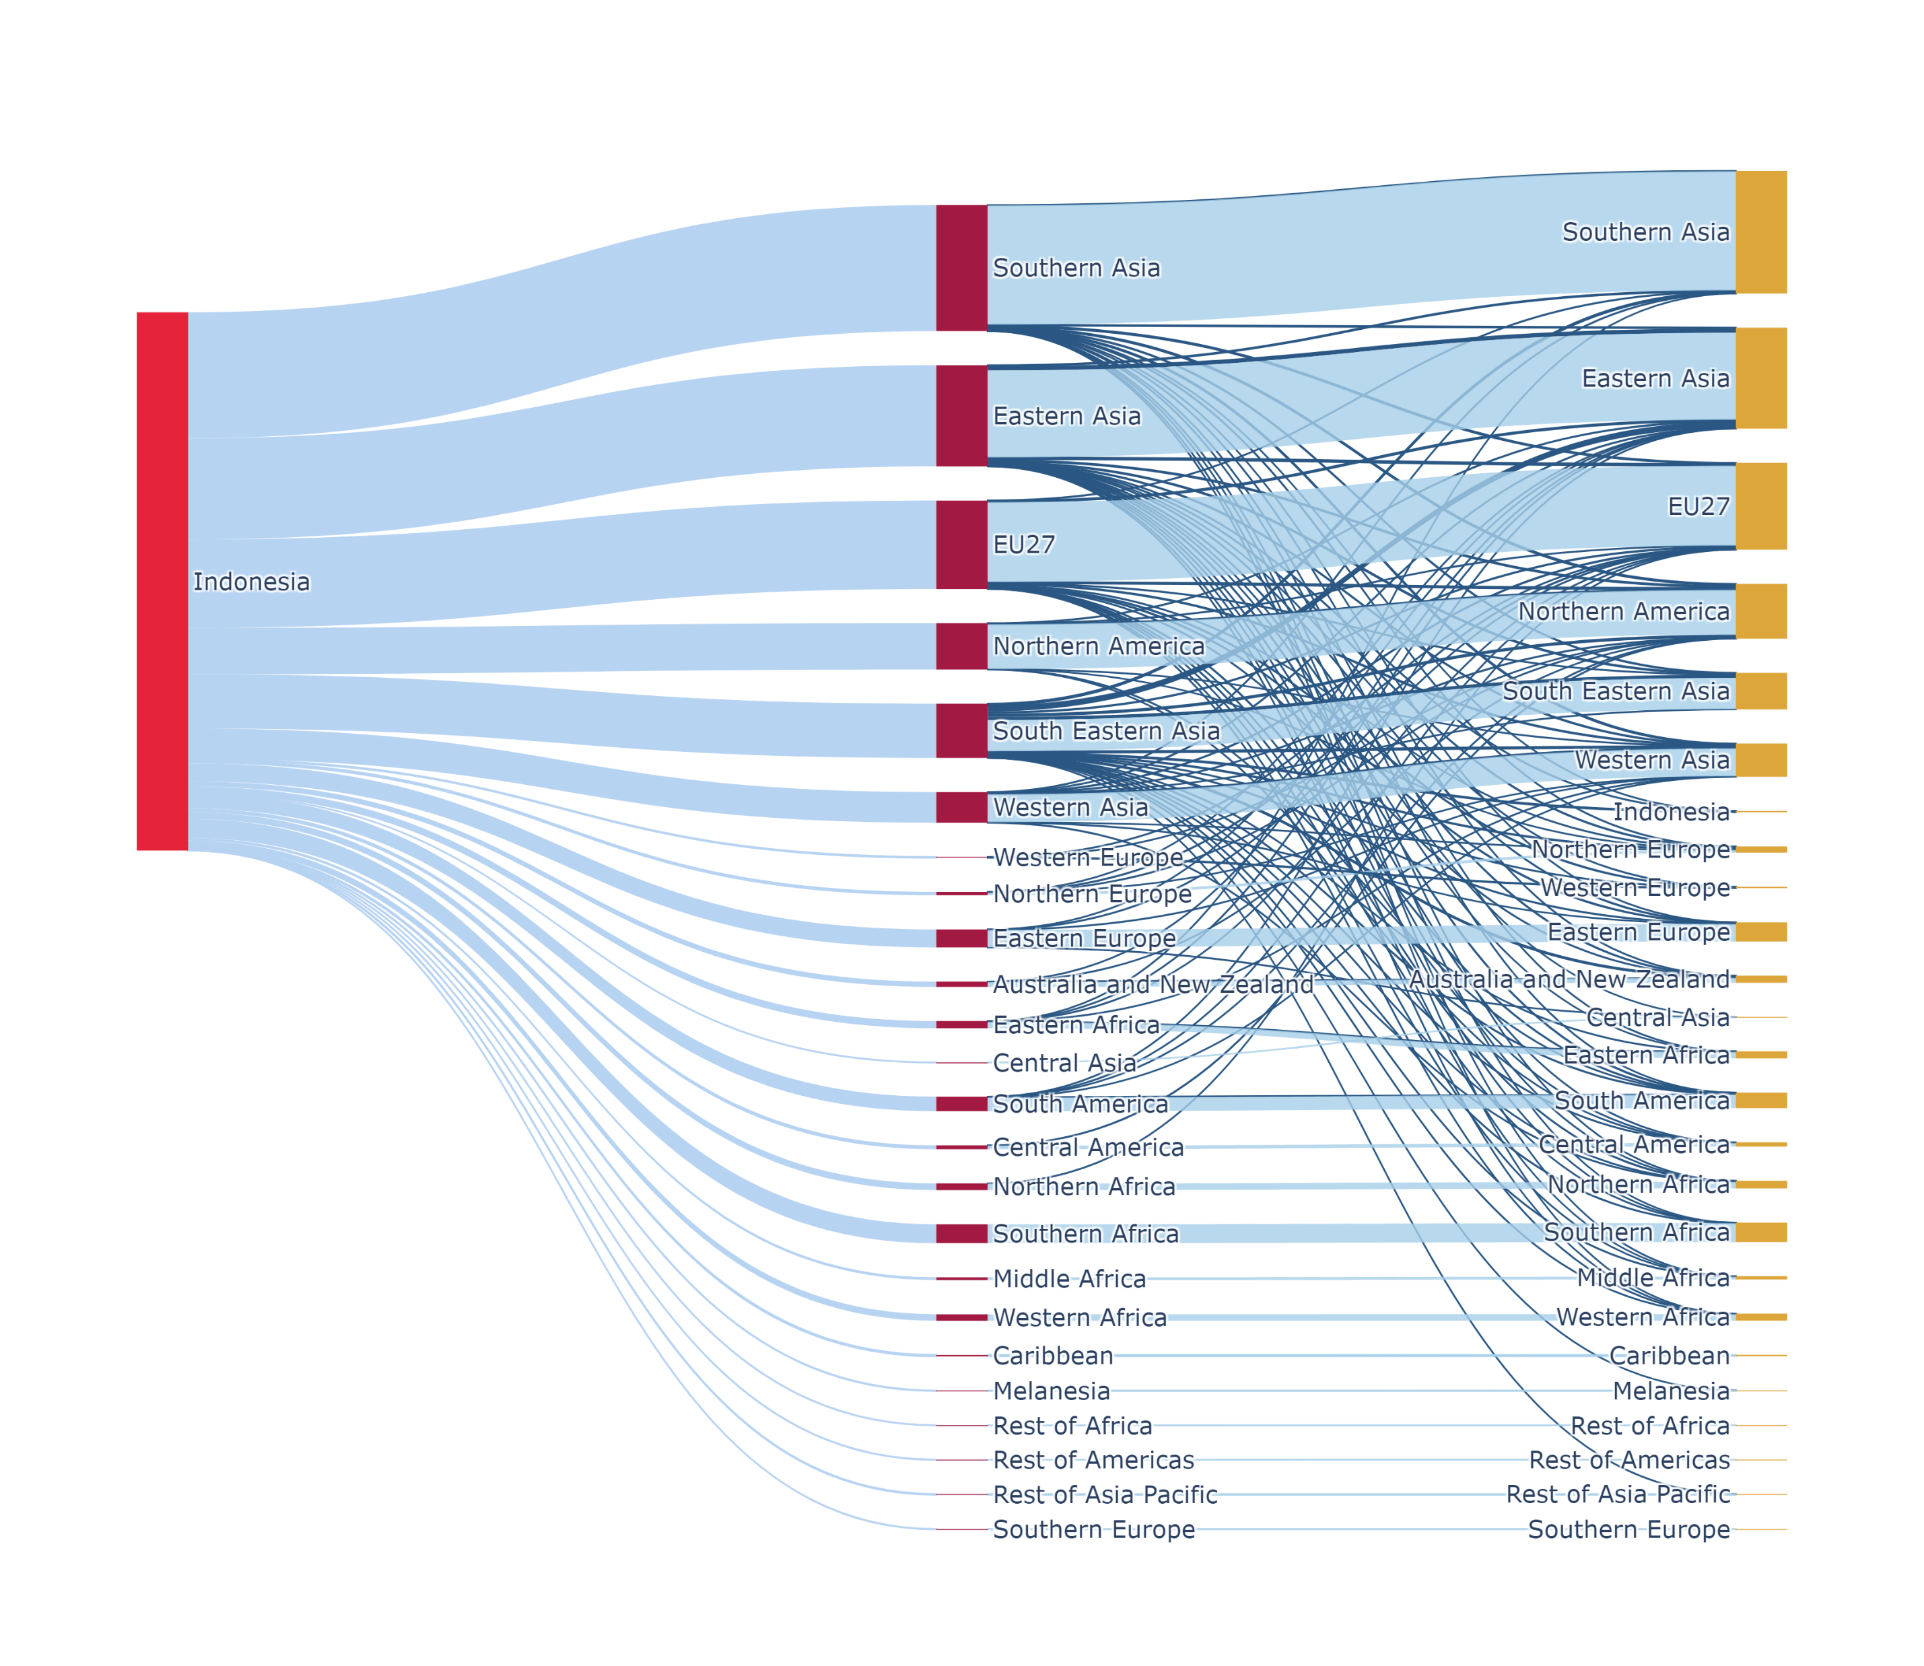
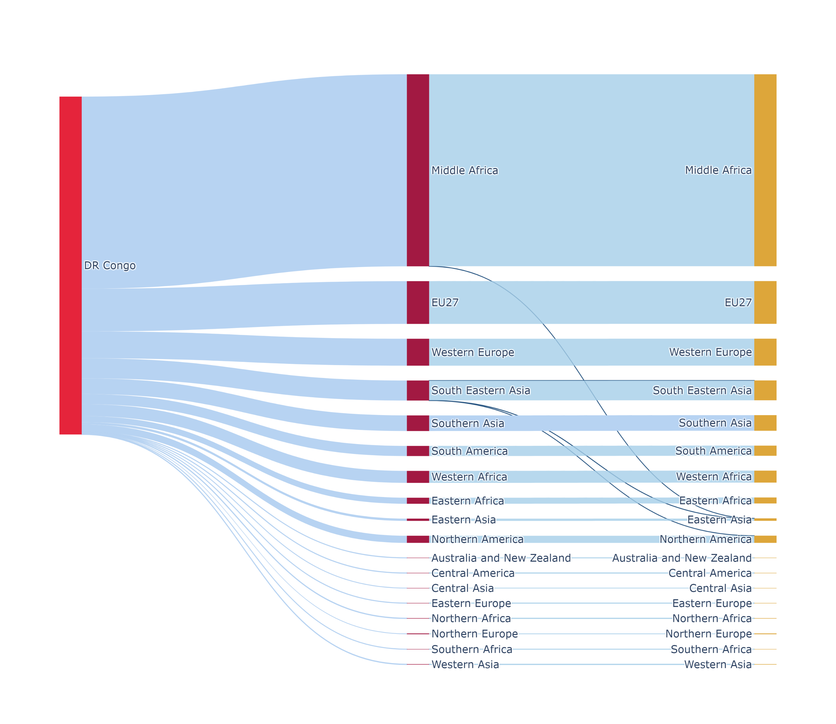
A
B
C
Quantity of deforestation linked to commodities consumed locally
Quantity of deforestation linked to commodities not consumed locally
Total amount of deforestation embodied in commodities arriving in a specific area,
accounting for both direct consumption and goods that are re-exported.
Direct consumption (commodities exported from the deforestation country
to a final consuming country).
Indirect consumption (commodities first exported to a country for processing,
then re-exported and consumed in a third country).
Total deforestation embodied in commodities consumed in the respective area

